Slide 1

Walmart's Data-Driven Hurricane Strategy
Emma Kee, Kylie Sharp, Raffaella Alpaca, and Miriam Ahmad

Slide 2

Table of Contents
01
02
03
04
05
Data Cleaning
API
Visuals
Questions
Conclusion

Slide 3

Data Cleaning
All files: Standardize text columns to lowercase
store_locations.csv | Change zip_code to string because identifiers, not quantities Standardize store_id to ‘fl-###’ and state to fl Remove duplicate rows because they convey the same store information
product_catalog.csv | Map inconsistent category values to canonical categories (i.e. “baby”: “baby products”) Infer missing subcategory values based on similar product descriptions Standardize product_name column (i.e. "pop-tarts strawberry": "strawberry pop-tart")
walmart_transactions.csv | Convert unit_price to be float, remove $, strip leading/trailing whitespace Convert timestamps to datetime format using format='mixed'to infer the format of each value individually Remove duplicate rows based on transaction_id Standardize store_id to ‘fl-###’ Change negative quantity values to positive
Notes:
For data cleaning, we broke the process into multiple steps: (1) previewing the data, (2) cleaning the store location data, (3) cleaning the product catalog, and (4) cleaning the Walmart transactions.
Before cleaning the data, we initially looked at the shape, data types, missing values, and duplicate rows for each dataset.
After reviewing the data, we focused on cleaning one dataset at a time. We started with the store location data. First, we standardized all text columns to lowercase and reviewed the data types to ensure they were appropriate for the information stored in each column. Then, we standardized the store_id column and state values. We dropped the duplicate store IDs because we did not want to overrepresent stores that conveyed the same information. We also created a new column containing the cleaned store_id information. In addition, we left one store location's longitude and latitude as NaN because we were unable to find an exact match for the store's location. We preferred accuracy over an estimate because we did not want to hinder future analysis with potentially incorrect data.
Moving on to the product catalog, we standardized all text columns to lowercase and standardized the category column using a mapping function. In addition, we filled in the missing subcategory values, as there were 13 missing values. Product names and categories also had missing values; however, we could infer the correct values based on matching or similar product descriptions, so we assigned values to fill in the missing information. We then standardized the product name column using mapping replacement values. We also reviewed similar naming conventions to ensure consistency and accuracy throughout the product catalog. There were 5 missing unit cost values, so we also standardized the package size column to ensure the package size information was consistent. In addition, we checked for duplicate SKU values and found that there were none.
After that, we cleaned the Walmart transaction data. We standardized the text columns to lowercase again and verified the data types of the columns. We determined that the unit price column would be better suited as a float rather than an object. To do this, we removed the $ symbol and stripped any leading or trailing whitespace. We then converted the timestamp column into a datetime object by parsing the timestamp values. Many of the original timestamp values were incompatible with Pandas' datetime parsing rules, so we used the format='mixed' parameter, which allowed Pandas to infer the format of each value individually. We then checked for missing values and duplicates. We dropped the duplicate rows because we did not want repeated records to inflate transaction counts and sales totals. We also standardized the formatting of the store ID in the transaction Data Frame so that it would match the store ID in the store DataFrame. Finally, we checked for invalid prices in the unit price column.
Finally, we cross-checked all three datasets. We found products that appeared under multiple SKUs. There were two types of duplicates: (1) the same product with the same package size but multiple SKUs, and (2) the same product name with different package sizes. We focused on records with the same product and package size. We then consolidated the records sharing a canonical SKU by averaging their unit costs while preserving the product information. At the end of the cleaning process, there were still missing values: 1 store missing longitude and latitude, 5 missing unit costs for products, and 884 missing timestamps in the transactions. We kept all these values as NaN. If we need to use latitude and longitude in future analysis, we could investigate this store more closely and verify its location online. If we analyze dates and times, we should exclude the 884 rows with missing timestamps.
Before data cleaning, there were inconsistencies in the sku and store_id columns, which serve as key identifiers linking the related datasets. During cleaning, we standardized these identifiers to ensure consistency across datasets. After cleaning, we were able to successfully combine all three datasets into one unified dataset.

Slide 4
Data Cleaning
All files: Standardize text columns to lowercase
distribution_centers.csv | Convert surge_capacity variable to integer data type for subsequent analysis and calculations Investigate missing values and retain as NaN when information cannot be reliably determined
inventory_and_sales.db | Checked both SQL tables for missing values and duplicate records Standardized date formats, store IDs, and SKUs to match the transaction data Identified 626 missing inventory order values and 34 negative revenue records; retained uncertain values rather than making assumptions
Notes:
For the distribution_centers.csv, we first standardized all text columns to lowercase. We then converted the surge_capacity variable to an integer data type so it could be used for future calculations. Finally, we reviewed the NaN values but decided to retain them as NaN since we could not reliably determine the missing information.
For inventory_and_sales, we worked with two tables: daily sales summaries and inventory levels. We checked for missing values and duplicates, standardized dates and product identifiers, and investigated negative revenue values. We also kept missing inventory order values as missing rather than replacing them with zero because we couldn't confirm what they represented.

Slide 5
API Section
Weather Data Source
Data Collection
Sales–Weather Join
Used the Open-Meteo Historical Weather API to retrieve daily precipitation and maximum wind speed for September 2024
Collected 330 daily weather records across 11 Walmart stores using their latitude and longitude coordinates.
Matched weather with sales using store ID and date. Preserved all 25,532 transactions and validated the join.
Notes:
For my part of the project, we worked on integrating historical weather data using the Open-Meteo API. We retrieved daily rainfall and maximum wind speed for September 2024 using the Walmart stores' coordinates.
We collected 330 weather records from 11 stores and then joined them with our sales transactions using the store ID and date. We also added validation checks to make sure the join didn't remove or duplicate any sales records.
One challenge was dealing with missing coordinates and timestamps, so we documented those limitations and our assumption that the sales timestamps were in Florida local time.

Slide 6
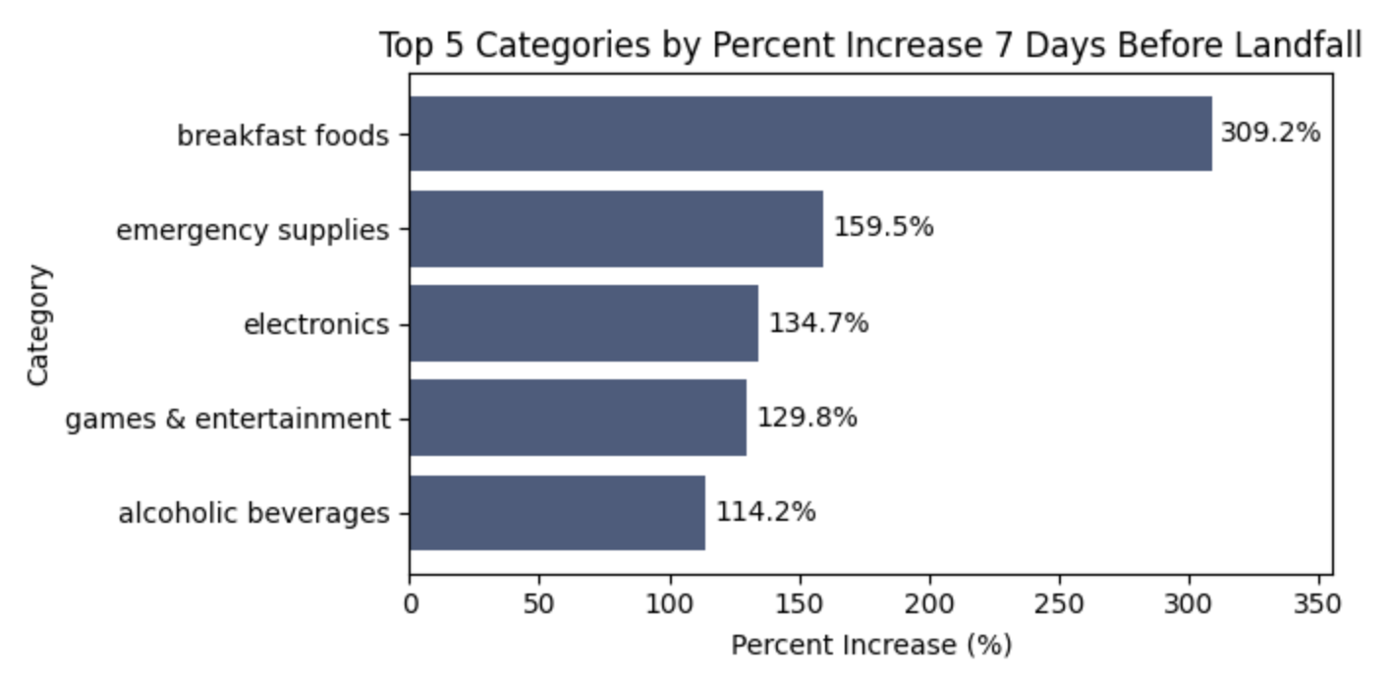
Visuals
Question 1: Categories by Percent Increase
Notes:
The bar chart shows the top 5 categories in regard to their percent increase of being bought the seven days before landfall compared to the 7-day period prior. Landfall was determined using wind speed as a proxy variable, and was left out of the windows so as not to skew results. Every category saw increase, but the five with the highest percent were “breakfast foods’, ‘emergency supplies’, ‘electronics, games, and entertainment’, and ‘alcoholic beverages.’ They are ordered decreasingly from top to bottom, with breakfast foods showing the most increase of all categories. The takeaway is that Walmart should make sure these categories are well stocked when a storm is forecast.

Slide 7
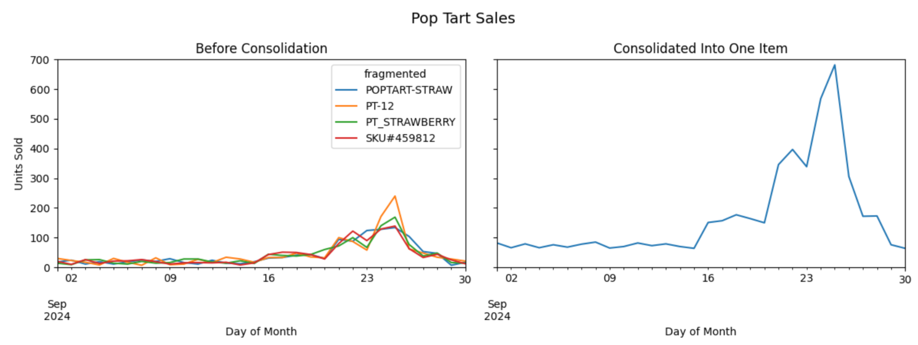
Visuals
Question 2: Pop Tart Consolidation
Notes:
The two line charts show the sale of pop tarts by day over the month of September. The figure on the left has multiple lines, each correlating to a different representation of the pop tart item within the dataset. The figure on the right shows the sales after all the variants have been combined into one, demonstrating the true number of pop tarts sold. The consolidated item of ‘poptarts’ ranks at the top of revenue and units sold. Knowing this, Walmart should keep them in stock in anticipation of a storm.

Slide 8
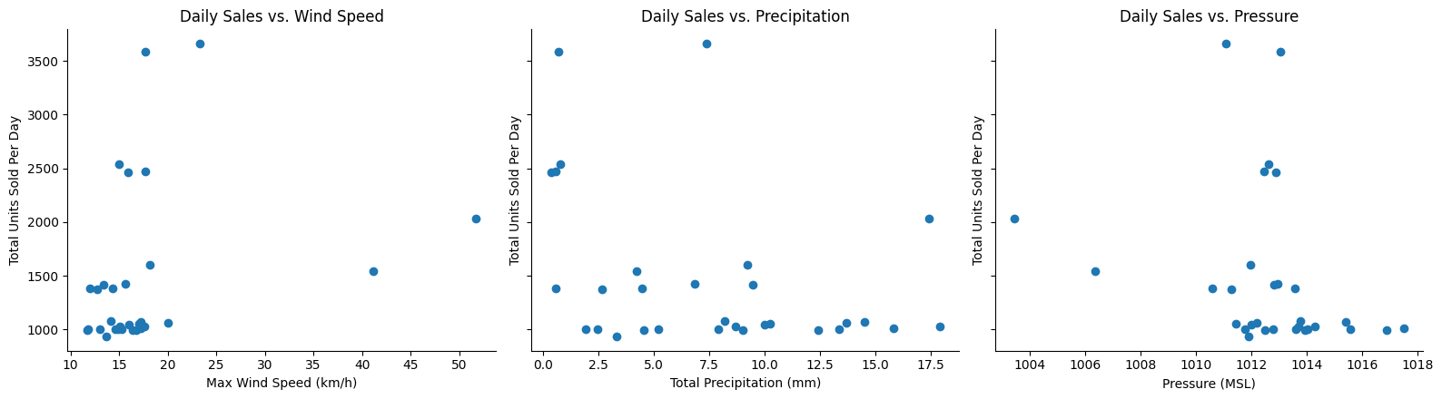
Visuals
Question 3: Weather vs. Sales
Notes:
The scatter plots chart sales against a certain weather condition. The both use total units sold per day on the y axis and map them against wind speed, precipitation, and pressure. There does not appear to be a strong correlation between either metric and sales. The correlation coefficients of 0.27, -0.37, and -0.28 (respectively) corroborate this conclusion–there is no clear link between proximity to landfall and the size of the surge. However, there was one statistical outlier, ‘fl-239.’

Slide 9
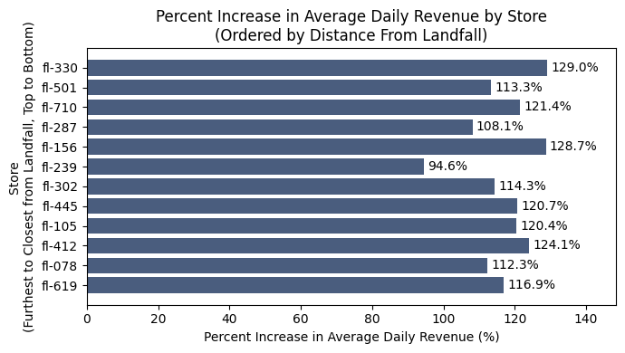
Visuals
Question 4: Store-Level Geographic Patterns
Outliers: fl-239
Notes:
The bar graph shows the stores’ percent increase in average daily revenue, ordered by the stores closest to landfall. There does not appear to be any relation between the stores’ revenue increase and their proximity to landfall.

Slide 10
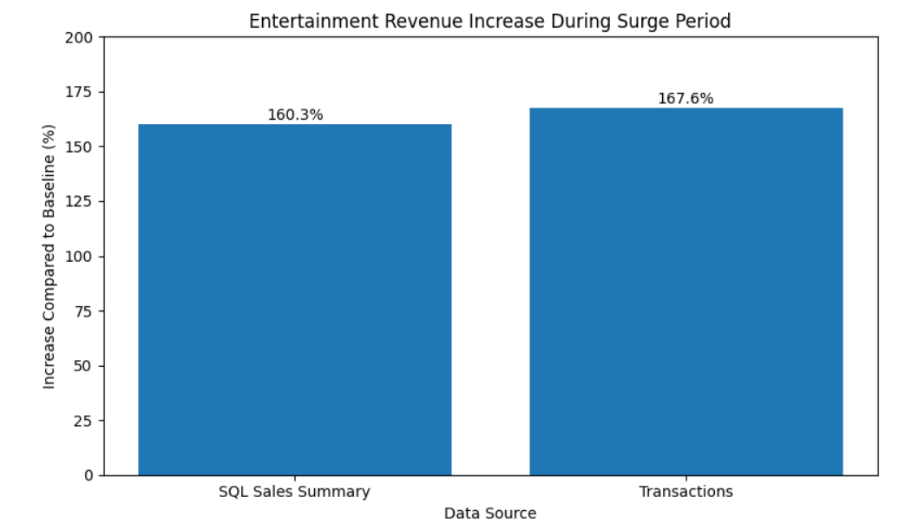
Visuals
Question 5: Board Games Investigation
Notes:
We wanted to determine whether the 250% increase in ‘entertainment’ sales was genuine or a data artifact. Both of datasets showed a similar increase: 160.3% in SQL and 167.6% in transactions, which suggests that there is a genuine demand increase. By using the side by side bar chart, it shows that the transactions and SQL Sales Summary are relatively similar. However, we noticed there were some SKU inconsistencies and incomplete inventory matches that make the exact increase uncertain. We also found that Monopoly was at or below its reorder point in 27% of inventory observations. Based on this graph and analysis, we recommend a modest, targeted increase in board-game inventory before future storms, while improving SKU standardization and inventory reporting.

Slide 11
Questions
Data Quality Impact | Inconsistent product names create discrepancies. By standardizing names, it improved data consistency and accuracy within later analysis.
ETL Trade-offs | We used format='mixed' to handle multiple timestamp formats and preserve valid timestamps. We kept missing values rather than estimating them to avoid introducing inaccurate data.
Pipeline Trust | API errors, missing timestamps, and incomplete inventory matches showed how data issues can affect results. We validated joins and documented limitations to improve reliability.
Business vs. Data | Both datasets showed a 160–168% Entertainment revenue increase. We recommended a modest inventory increase to balance potential demand with the risk of overstocking.
Key findings
There were inconsistencies in the sku and store_id columns, which serve as key identifiers linking the related datasets, that needed to be standardized and cleaned.
Both SQL and transaction data showed a significant increase in Entertainment sales during the selected surge period.
SKU inconsistencies, missing inventory matches, and negative revenue records highlighted data-quality limitations.
Walmart should consider a targeted inventory increase rather than relying solely on the reported 250% surge.
Notes:
Data Quality:
One data quality issue we encountered was inconsistent product naming across the datasets. For example, the same product could appear as “first aid kit” or “first-aid kit.” These variations caused the same product to be treated as separate items in our analysis. To address this, we standardized product names to group identical items together. As shown in the visualizations, this consolidated fragmented sales data, making product-level trends easier to identify and ensuring a more accurate analysis.
ETL:
We converted the timestamp column to datetime using format='mixed' to accommodate the dataset's multiple timestamp formats, preventing the missing value count from increasing from 884 to 23,028. Rather than keeping the original parsing method or filling missing timestamps with estimated values, we chose to preserve the original missing values to avoid losing usable data or introducing inaccurate information that could distort our analysis.
Pipeline Trust:
While working on the Weather API, we realized that even if our analysis is correct, problems with the data can affect our results. We encountered API errors, missing timestamps, and incomplete matches, so validating the pipeline was really important.
Business vs Data:
Our SQL and transaction data both showed an increase in Entertainment sales, but we also found inconsistencies. We didn't want Walmart to overstock products based on incomplete information, so we recommended a smaller inventory increase.

Slide 12

Thanks!
Questions?

